Slide 1

CAPSTONE PROJECT ON :- HEALTH INSURANCE CROSS SELL PREDICTION
BY : - ASHWANI BIST

Slide 2
INTRODUCTION
An insurance policy is an arrangement by which a company undertakes to provide a guarantee of compensation for specified loss, damage, illness, or death in return for the payment of a specified premium. There are multiple factors that play a major role in capturing customers for any insurance policy. Here we have information about demographics such as age, gender, region code, and vehicle damage, vehicle age, annual premium, policy sourcing channel. Based on the previous trend, this data analysis and prediction with machine learning models can help us understand and predict the data.

Slide 3
CONTENT
PROBLEM STATEMENT
DATA DISCRIPTION
EDA
FEATURE SELECTION
BEST MODEL FOR PREDICTION
CONCLUSION
CHALLENGES

Slide 4

PROBLEM STATEMENT
Our client is an insurance company that has provided Health Insurance to it's customers. Now they need your help in building a model to predict whether the policyholders (customers) from the past year will also be interested in Vehicle insurance provided by the company. An insurance policy is an agreement by which a company undertakes to provide a guarantee of compensation for specified loss, damage, illness, or death in return for the payment of a specified premium.

Slide 5
DATA DISCRIPTION
id : Unique ID for the customer
Gender : Gender of the customer
Age : Age of the customer
Driving_License 0 : Customer does not have DL, 1 : Customer already has DL
Region_Code : Unique code for the region of the customer
Previously_Insured : 1 : Customer already has Vehicle Insurance, 0 : Customer doesn't have Vehicle Insurance
Vehicle_Age : Age of the Vehicle
Vehicle_Damage :1 : Customer got his/her vehicle damaged in the past. 0 : Customer didn't get his/her vehicle damaged in the past.
Annual_Premium : The amount customer needs to pay as premium in the year
PolicySalesChannel : Anonymized Code for the channel of outreaching to the customer ie. Different Agents, Over Mail, Over Phone, In Person, etc.
Vintage : Number of Days, Customer has been associated with the company
Response : 1 : Customer is interested, 0 : Customer is not interested

Slide 6
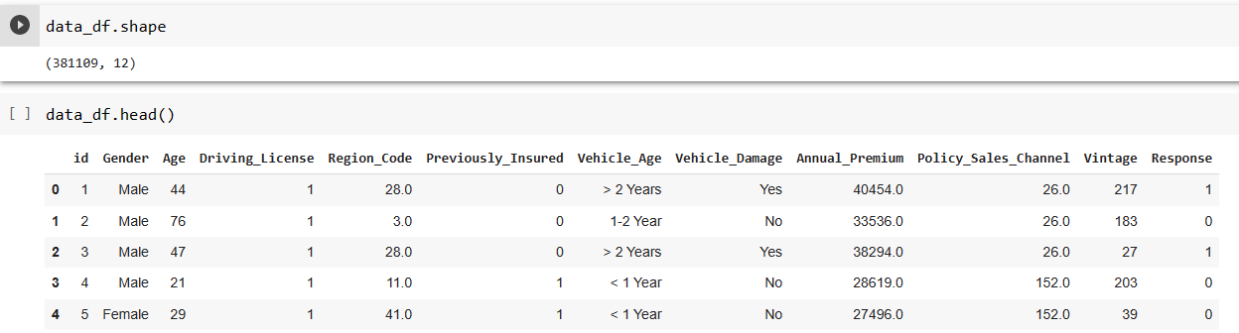
OVERVIEW OF DATA
There are 381109 of rows present in the data set.
There are 12 columns present present in the data set

Slide 7
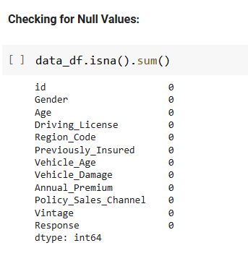
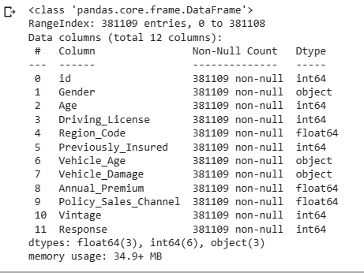
OVERVIEW OF DATA SET
We do not have any Null Values in our dataset.
We have 4 numeric and 5 categorical independent features.
Our dependent feature is a categorical column (Response)

Slide 8
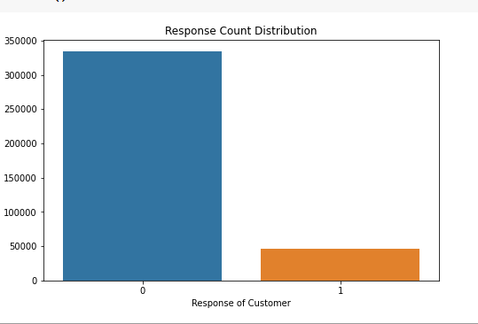
RESPONSE COUNT DISTRIBUTION
As we know, that in "Response" column 1 shows the customers who are interested in vehicle insurance whereas 0 indicates the customers who aren't interested in vehicle insurance.
From the chart we can clearly see that very less number of customers interested in vehicle insurance

Slide 9
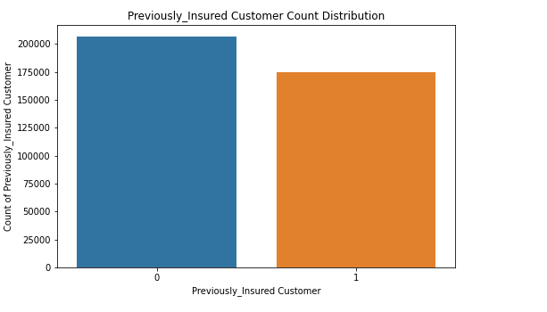
PREVIOUSLY INSURED CUSTOMER
From the chart we can clearly see that the distribution of previously insured customers is very different from the customer response distribution and it is a big concerns for us as it's clearly stating that customers aren't happy by the previous services.

Slide 10
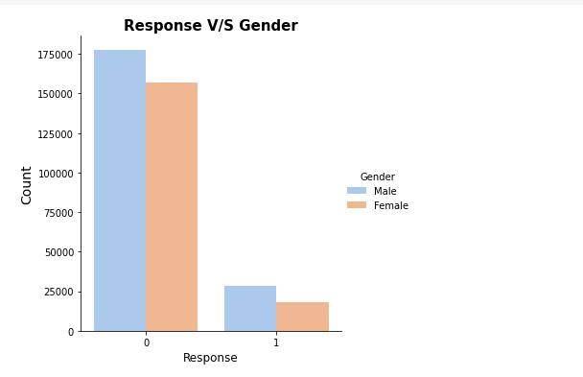
GENDER DISTRIBUTION
For the plot, we can say that the no. of male customers in our data set is higher than female customers.

Slide 11
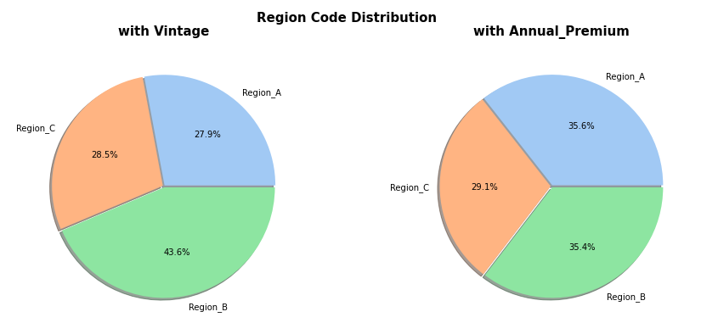
REGION CODE DISTRIBUTION
The above two pie plots shows the distribution of Region_Code in the Data set based on Vintage and Annual_Premium.

Slide 12
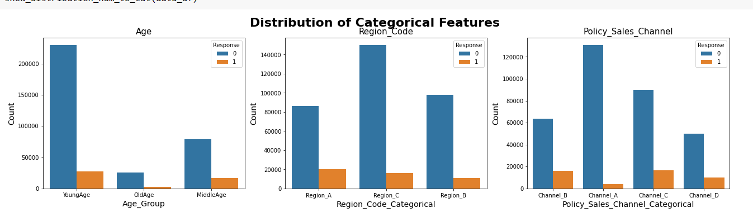
DISTRIBUTION OF CATEGORICAL FEATURE
We can see that Customers belonging to Young Age group are more likely not interested in taking the vehicle insurance.
Similarly, Region_C and Channel_A Customers has the highest chances of not taking the vehicle insurance.

Slide 13
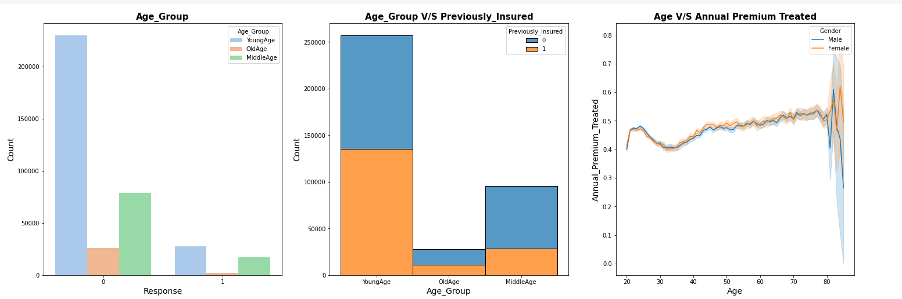
EXPLORING THE AGE FEATURE
From the first plot, we can see the Responses received from the different Age_Group.
Second plot shows the number of customers of different age group having or not having vehicle insurance.
We can say that the customers of YoungAge and OldAge are equally likely to have/not have vehicle insurance whereas customers of MiddleAge has the highest chances of not having a previously insured vehicle insurance.
From the third plot, we can see the relation between Age and their Annual_Premium for both Male and Female customers

Slide 14
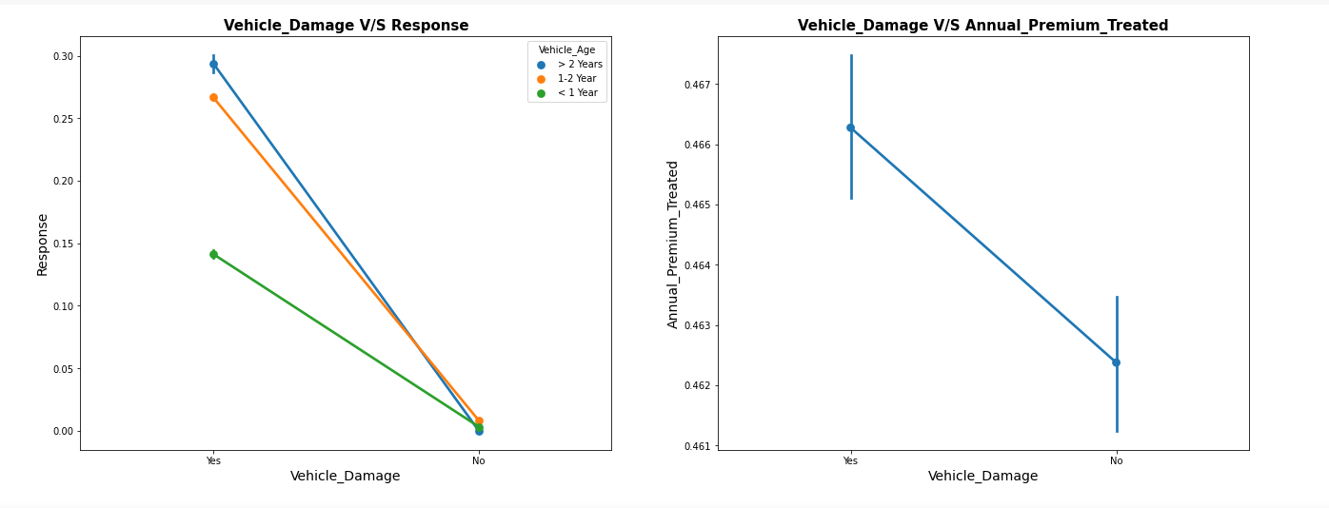
EXPLORING VECHICLE DAMAGE
From the first point plot, we can say that the chances of taking a vehicle insurance is higher if vehicle is damaged irrespective of VehicleAge group. With the increase in vehicle age, the chances of taking vehicle insurance also increases.
The second point plot says that the Annual_Premium is comparetively higher for customers with damaged vehicle.

Slide 15
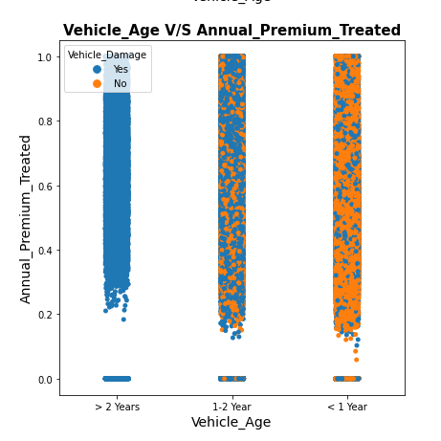
EXPLORING VECHILE AGE GROUP
The plot shows that the customers having vehicle age >2 Years have the higher chances of taking vehicle insurance.

Slide 16
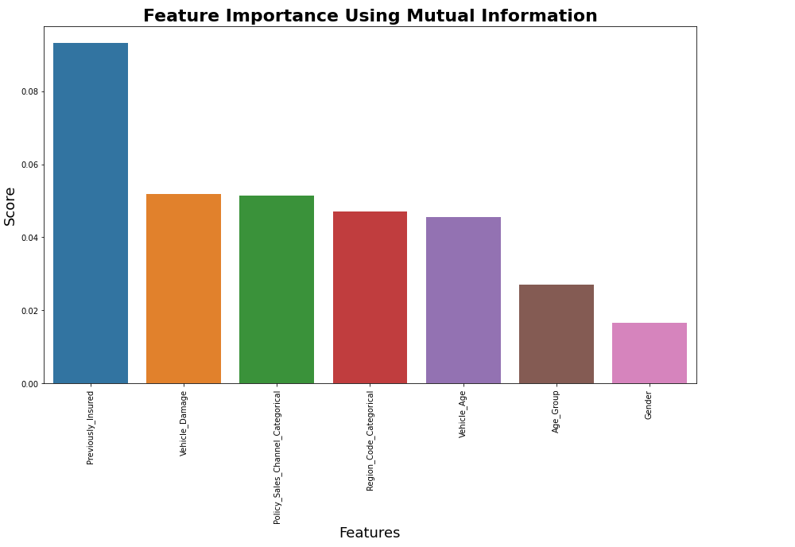
EXPLORING MUTUAL INFORMATION
From the above bar plot, we can conclude Previously_Insured is the most important feature and has the highest impact on dependent feature.

Slide 17
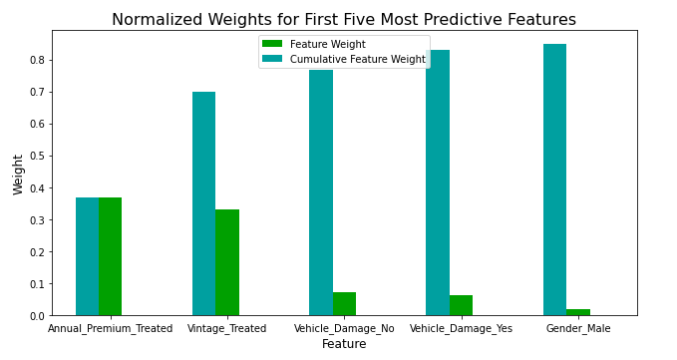
EXPLORING NORMALISED WEIGHT
Annual_Premium_Treated has impacted the most in the prediction.
Gender_Male has highest feature weight but less cumulative weight.

Slide 18
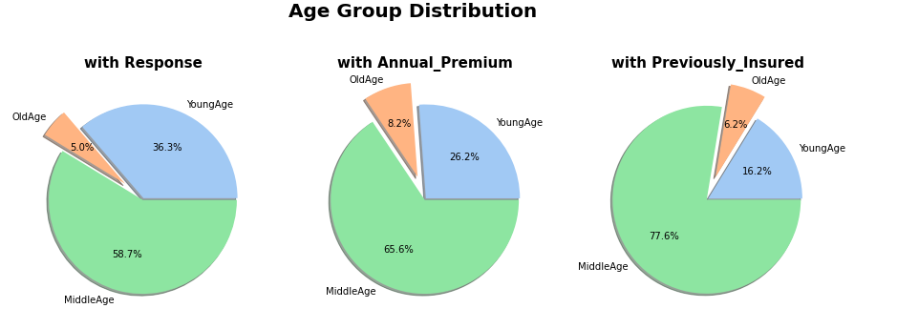
AGE GROUP DISTRIBUTION
The above three pie plots shows the distribution of Age_Group in the Data set based on Response, Annual_Premium and Previously_Insured.

Slide 19
BEST MODEL
From all the models that we tried to train and predict the output, we can conclude that Bagging Classifier is the best model for our data set. The best parameter of this model is Its Accuracy Score is 0.85, Precision is 0.31.
We can see that we have other models with higher Accuracy Score than Bagging Classifier. But the problem with those models is, their Precision and Recall values are zero which means True Positives are zero. That means those models are unable to predict correct output if any customer is ready to take vehicle insurance. And as we all know, classification accuracy alone can be misleading if you have an unequal number of observations in each class. This is exactly the case with our data set
Hence, Bagging Classifier is the best model for our data set.

Slide 20
CONCLUSION
Customers belonging to youngAge are more interested in vehicle response.
Customers having vehicles older than 2 years are more likely to be interested in vehicle insurance.
Customers having damaged vehicles are more likely to be interested in vehicle insurance.
Previously_Insured is the most important feature and has the highest impact on the dependent feature and there is no correlation between the two numeric features.

Slide 21

CHALLENGE
Data set was not easy to understand and manipulate.
Challenging to identify and fit the right model for tha data due to the problem is Binary nature.
Identifying the key factors and deciding best fit models after getting results of models.
We were unable to do visualization and fitting of model easily due to bulk and running models were taking lot of time.

Slide 22


